Slide 1

ADG-HACKATHON
HELPID

Slide 2
Type, to assure as far as possible every working man and woman in the Nation safe and healthful working conditions a quote here.

Slide 3
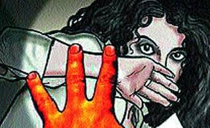
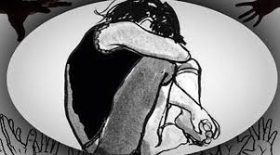
PROBLEM FACED BY WOMaNS
MOLESTATION
EVE TEASING
WOMAN INSECURITY
MORE SUFFERATION

Slide 4
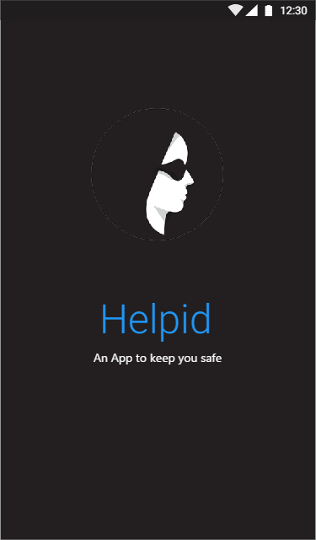
THE SOLUTION
HELPID

Slide 5
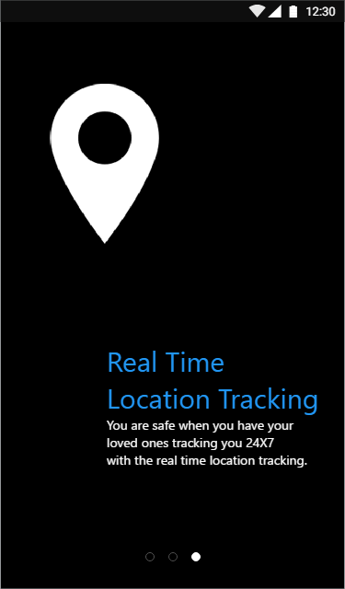
REAL TIME TRACKING OF THE CONCERNED PERSON
LOCATION OF USER IS TRACKED EVERY SECOND.
GIVES DETAILS OF LOCATION TO EMERGENCY CONTACT PEOPLE (chosen by user).

Slide 6
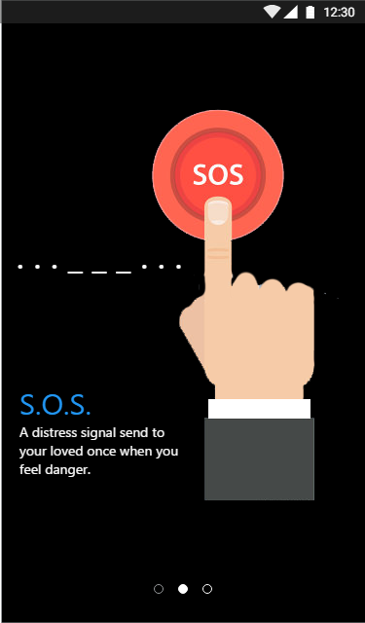
PRESS POWER BUTTON THREE TIMES
GENERATES SOS.
CALLS TO EMERGENCY CONTACTS
SENDS NOTIFICATION :
IF NOT HAVING APP, MAIL WILL BE SENDING TO NEARBY PEOPLE WITH LOCATION OF USER.
ELSE, OPEN AND SEE ALL LOCATIONS WHERE MOLESTATION IS HAPPENING.

Slide 7
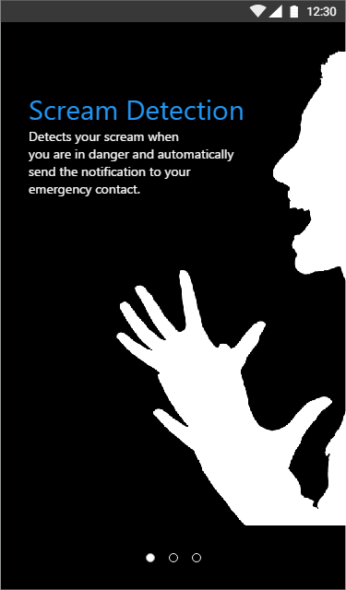
recording
RECORDS VOICE INSTANTLY
DETECTS YOUR SCREAM WHEN YOU ARE IN DANGER AND AUTOMATICALLY SEND THE NOTIFICATION TO YOUR EMERGENCY CONTACTS.
SAVE RECORDING AND SEND IT TO NEARBY POLICE STATION
CAN ACT AS PROOF FOR USER.

Slide 8
STORE SOS ALARMS
POLICE WILL GET TO KNOW IN WHICH REGION MAXIMUM CASES ARE OCCURRING.
HELP OTHER PEOPLE TO KNOW WHICH ROUTES ARE SAFE TO GO.
POLICE CAN TAKE BETTER ACTIONS ACCORDINGLY.
CAN BE USED IN FUTURE ALSO.

Slide 9
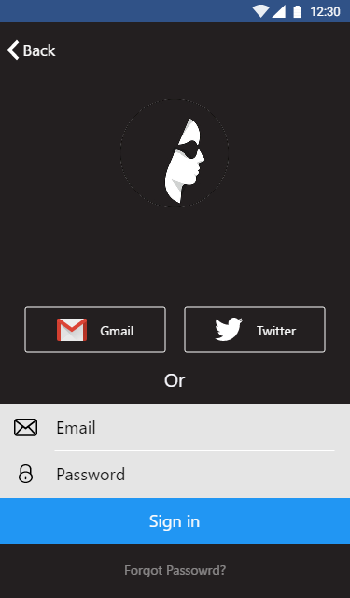
PREVENT SPAMMING
USING:
USING GMAIL AND FACEBOOK LOGIN
REQUIRES USERNAME AND PASSWORD.

Slide 10
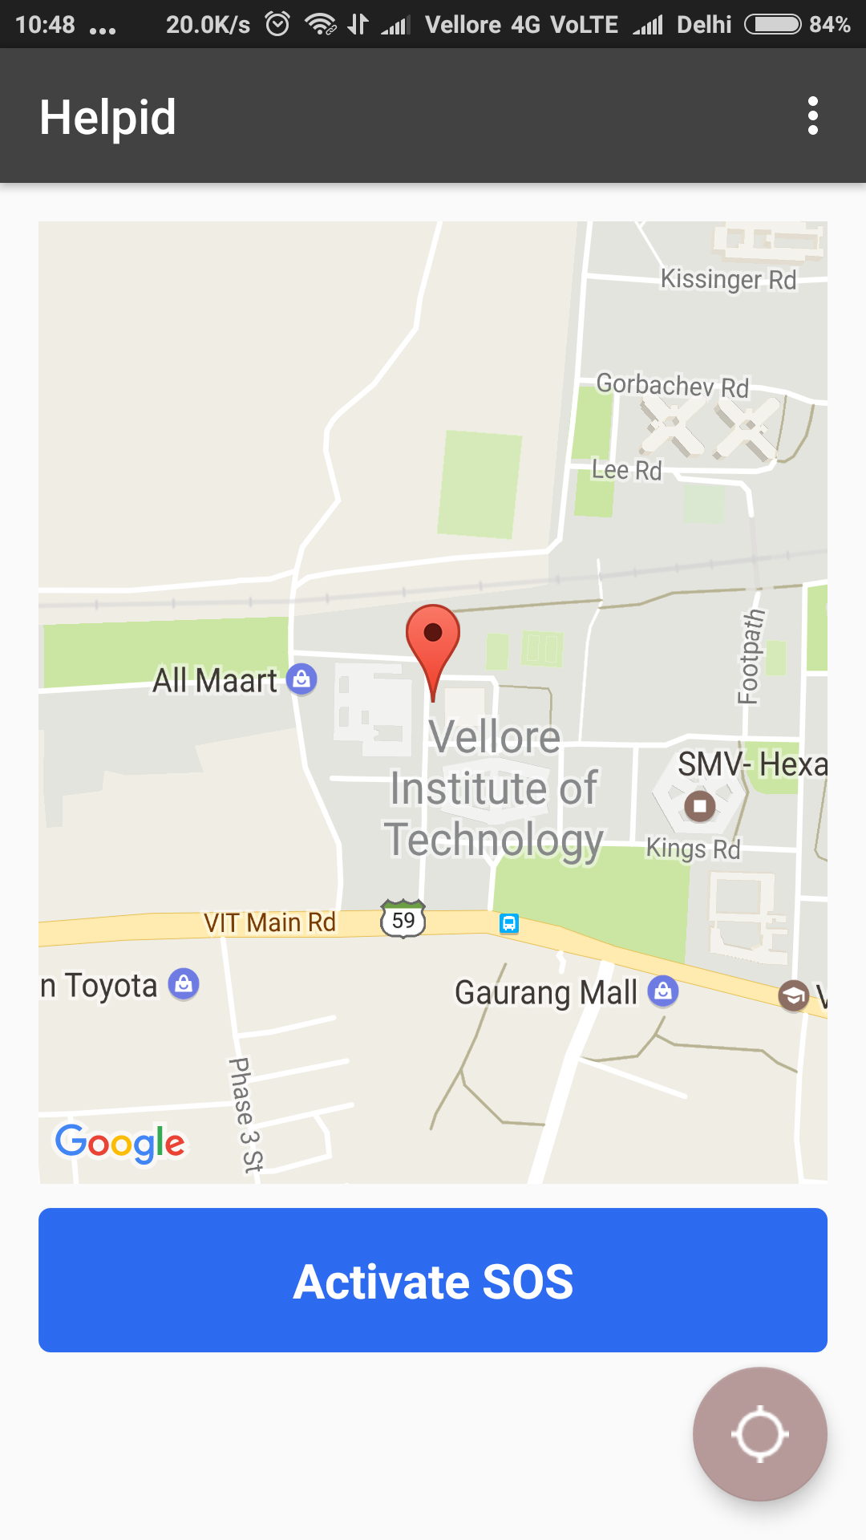
INSTANT LOCATION
USER’S LOCATION IS SEND TO NEARBY PEOPLE.
PEOPLE CAN HELP IN CASE WHEN POLICE NOT BE ABLE TO REACH.

Slide 11
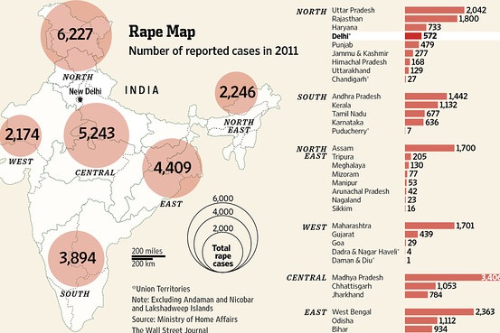
THE MARKET AND BUSINESS PLAN
POPULATION IN US - 318.9 million!
COVERS 65 COUNTRIES
IN INDIA - 627000
ASSUMING 25% DOWNLOADS
AT 2022, WILL BECOME 1 LAKH DOWNLOADERS.

Slide 12
BUISNESS MODEL AND MARKETING PLAN

Slide 13
FUNDING

Slide 15
SUMMARY

Slide 16
WHY?
COMING LATE IN NIGHT

